Slide 1
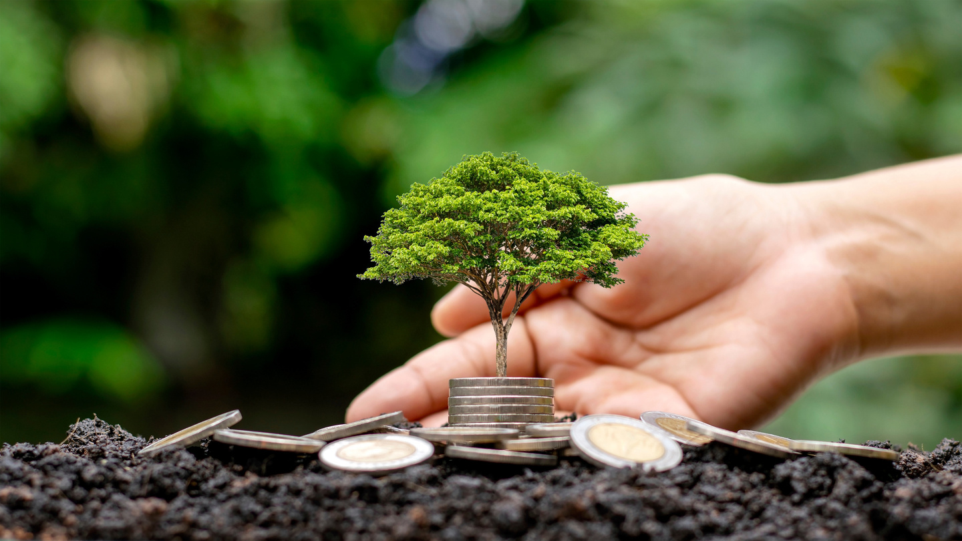


CIRCULAR
ECONOMY AND GREEN BUSINESS

Slide 2

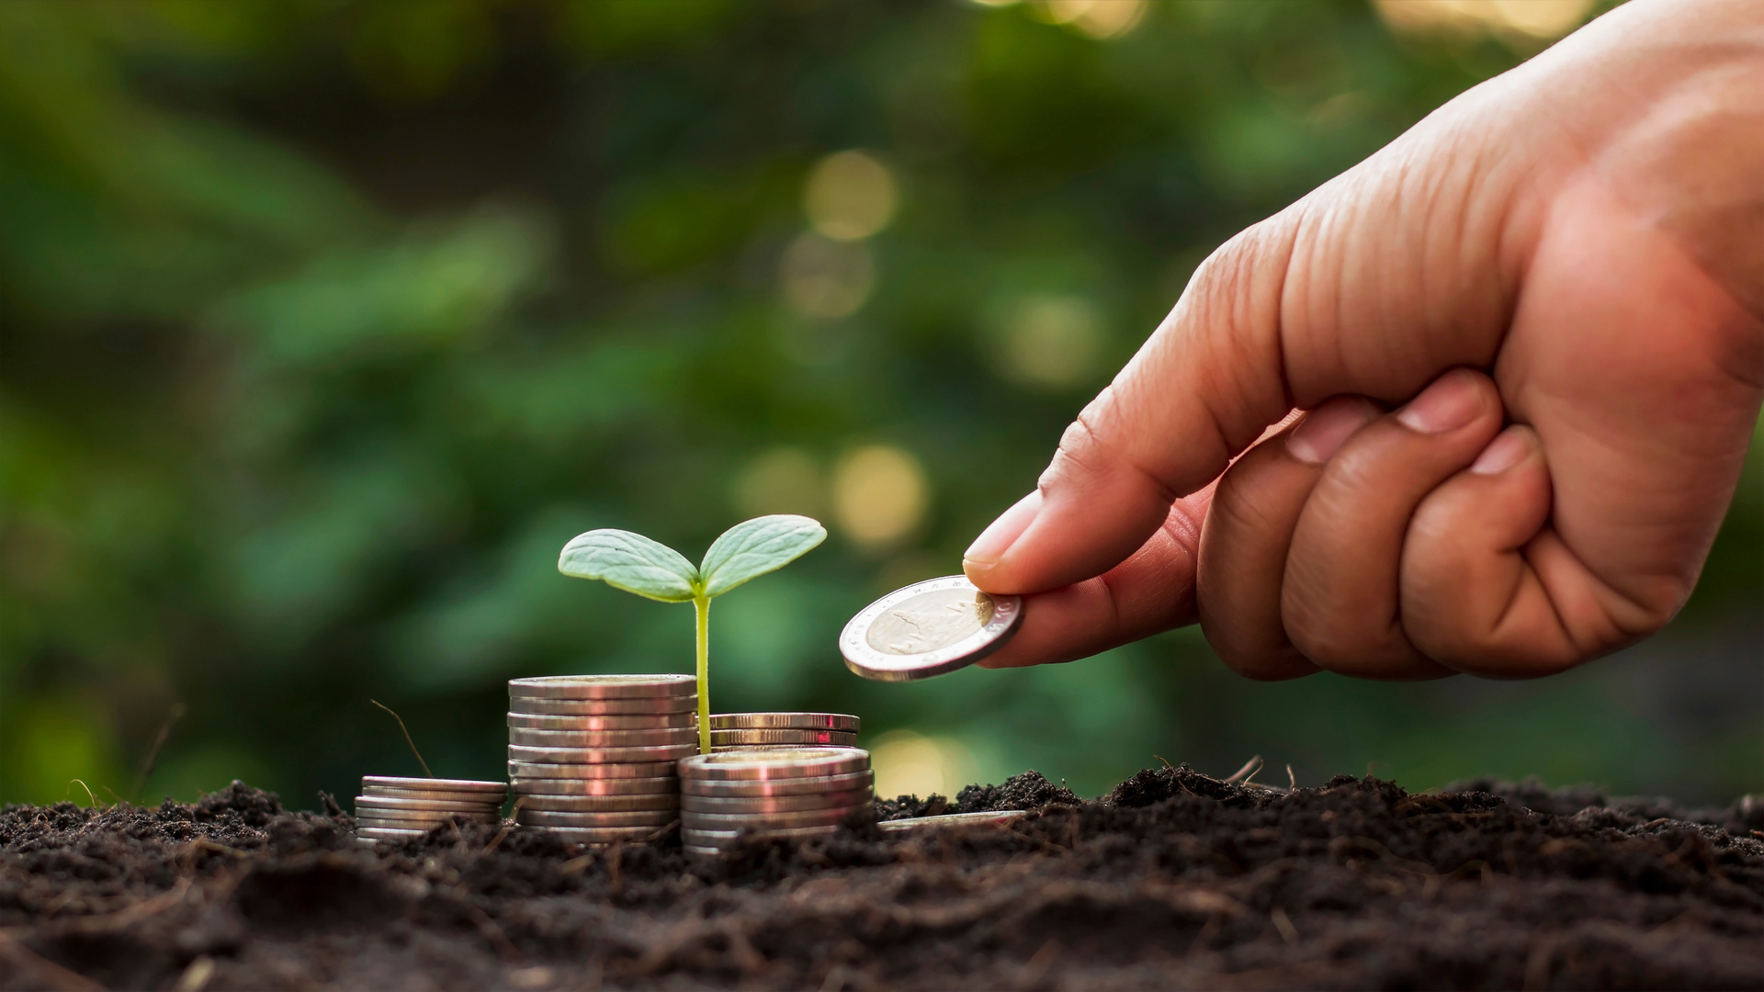
FROM LINEAR
TO CIRCULAR
Why change is necessary
The linear economy extracts, uses, and discards, producing massive waste and harming ecosystems. The circular economy rethinks this process by extending product lifespans, reusing materials, and regenerating resources. It reduces climate risks, boosts industries, and creates a resilient future built on collaboration, innovation, and sustainability for global society.

Slide 3

Foundation for change
CORE
PRINCIPLES
Eliminate Waste
Reuse Materials
Products are designed from the start to minimize environmental damage and avoid unnecessary disposal through careful planning.
Items are repaired, adapted, and maintained so resources keep circulating effectively instead of being lost too early.
Regenerate Nature
Circulate Products
Support natural systems by reducing extraction, restoring biodiversity, and ensuring ecosystems thrive with long-term sustainability.
Keep goods and materials in loops by recycling, remanufacturing, and sharing, extending their usefulness within society.

Slide 4


Protecting Nature Through Change
Reduced Pollution
Recycling and sustainable design cut emissions, prevent unnecessary burning, and limit plastic waste entering oceans and landfills worldwide.
Ecosystem Balance
Circular practices restore biodiversity, conserve water resources, and protect soil quality for agriculture and future generations.
ENVIRONMENTAL
GAINS

Slide 5
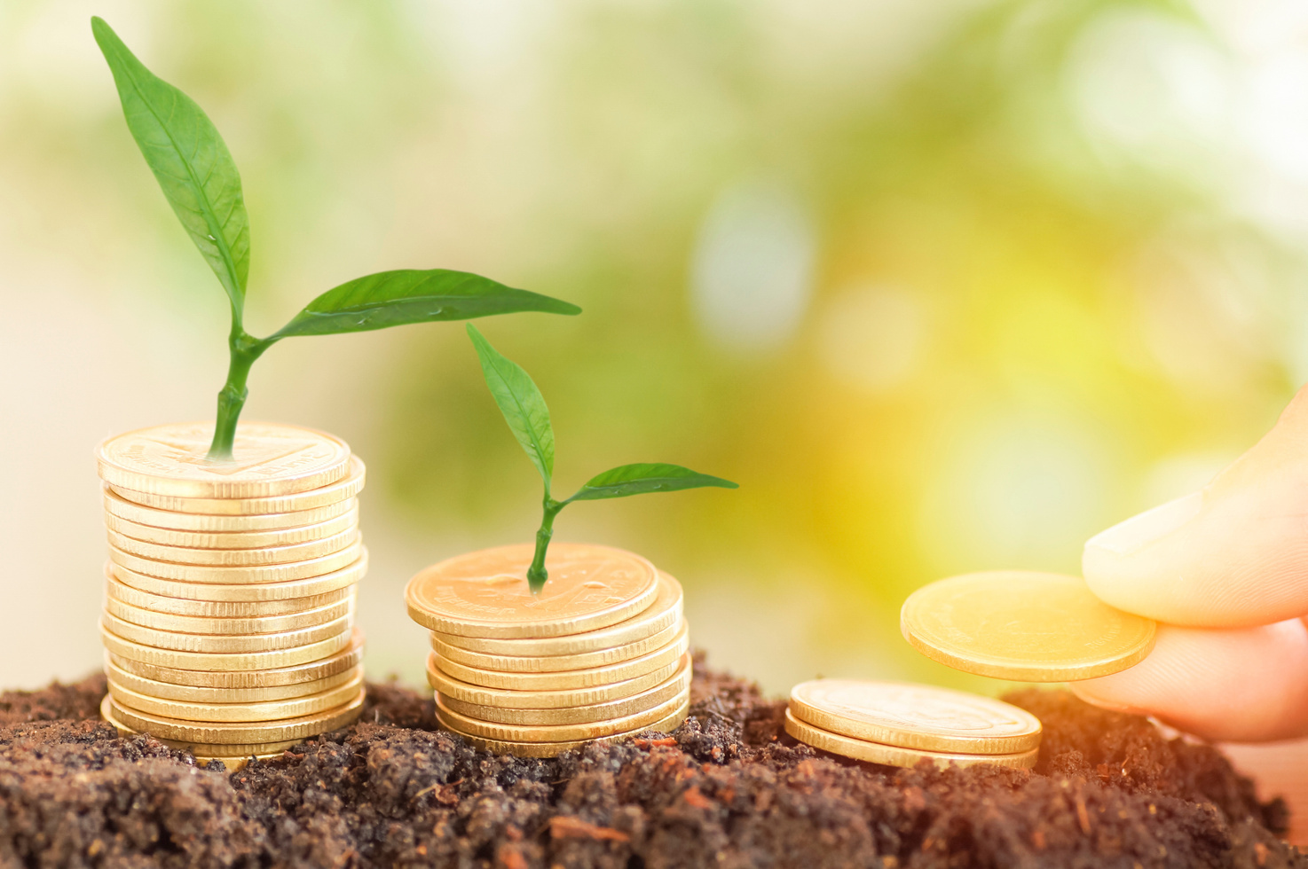
ECONOMIC
OPPORTUNITIES
Growth through circularity
Circular economy develops green industries, renewable energy markets, and sustainable packaging. It reduces dependence on finite resources while supporting jobs, lowering costs, and building competitive businesses prepared for tomorrow.
Collaboration across sectors accelerates innovation. With shared responsibility, industries and consumers unlock growth, build resilience, and deliver responsible value that respects both society and environment.

Slide 6
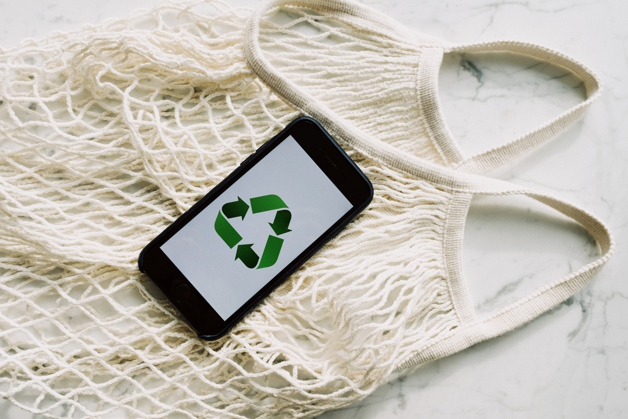
Sustainable Habits for Future
CIRCULAR
PRACTICES
Sharing Economy
Platforms reduce ownership needs through rentals, car-sharing, and product access. This cuts production, saves resources, and promotes efficiency across communities.
Product Design
Goods are made durable, modular, and repairable. This reduces demand for raw materials, lowers waste, and increases value circulation.
Industrial Symbiosis
Companies collaborate so one’s waste becomes another’s raw input. This lowers costs, limits extraction, and strengthens interconnected supply chains.

Slide 7

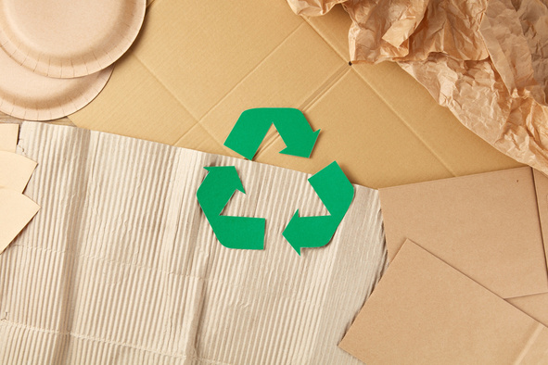
GREEN
BUSINESS
“Green businesses incorporate principles of sustainability into their business decisions in order to reduce their negative impacts on the global or local environment. They do this by selling environmentally friendly products or by greening their processes to make them more environmentally sustainable”

Slide 8
WHY GREEN BUSINESS MATTERS
Stay ahead of environmental regulation
Environmental regulation is becoming more and more stringent. Green businesses can reap the benefits of staying ahead of environmental regulation.
Access new markets
There is an increasing demand for green products and services worldwide
Access to finance
Green businesses may be able to attract certain types of financing options for their green business ideas
that are not be available for conventional business idease
IN TODAY’S WORLD?
Reduce costs
These cost reductions generally arise from efficiency gains when less inputs are required to produce the same output.
Improve quality
Green products and services can therefore improve the value proposition of the enterprise and improve its bottom line.

Slide 9
WHY GREEN BUSINESS MAKES
ECONOMIC SENSE?
Competitive Advantages
Green business practices provide economic benefits like cost savings through energy efficiency, innovation in eco-friendly products, and increased consumer appeal by attracting sustainability-focused customers.
ESG and Investment Trends
Companies with strong ESG profiles attract more investment and benefit from better financing terms.
Enhanced Brand Loyalty
Green businesses often build stronger brand loyalty by aligning with customers' values and commitments to sustainability.

Slide 10
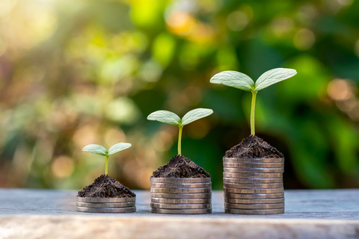
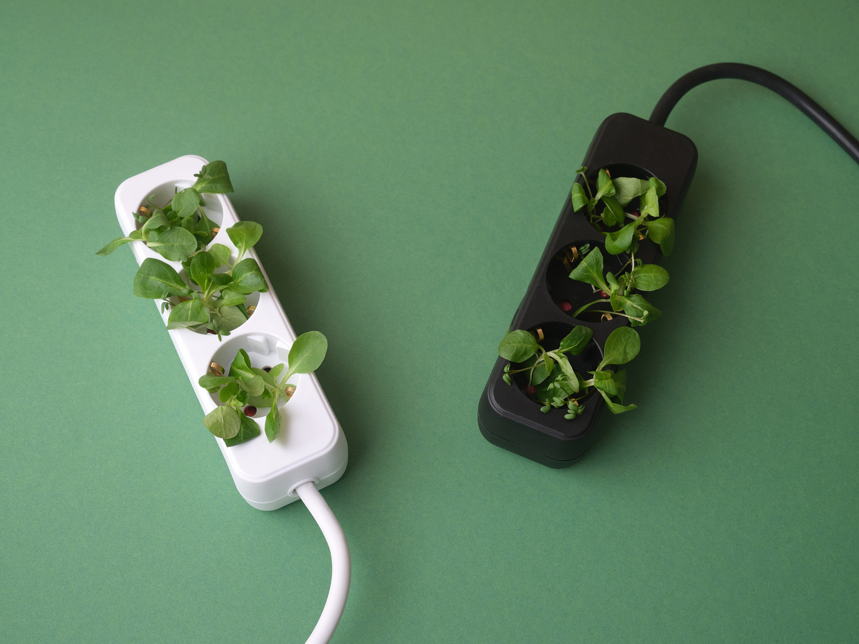

FUTURE
OPPORTUNITIES
Green Consumerism
Rising demand for eco-friendly products and responsible brands fuels growth. Businesses respond with transparency and accountability.
Innovation Drive
Global Collaboration
Partnerships and international policies accelerate circular adoption, improving economic stability and protecting ecosystems worldwide.
Inspires technology, product design, and new services. Circularity encourages entrepreneurship, building stronger markets and sustainable solutions.

Slide 11
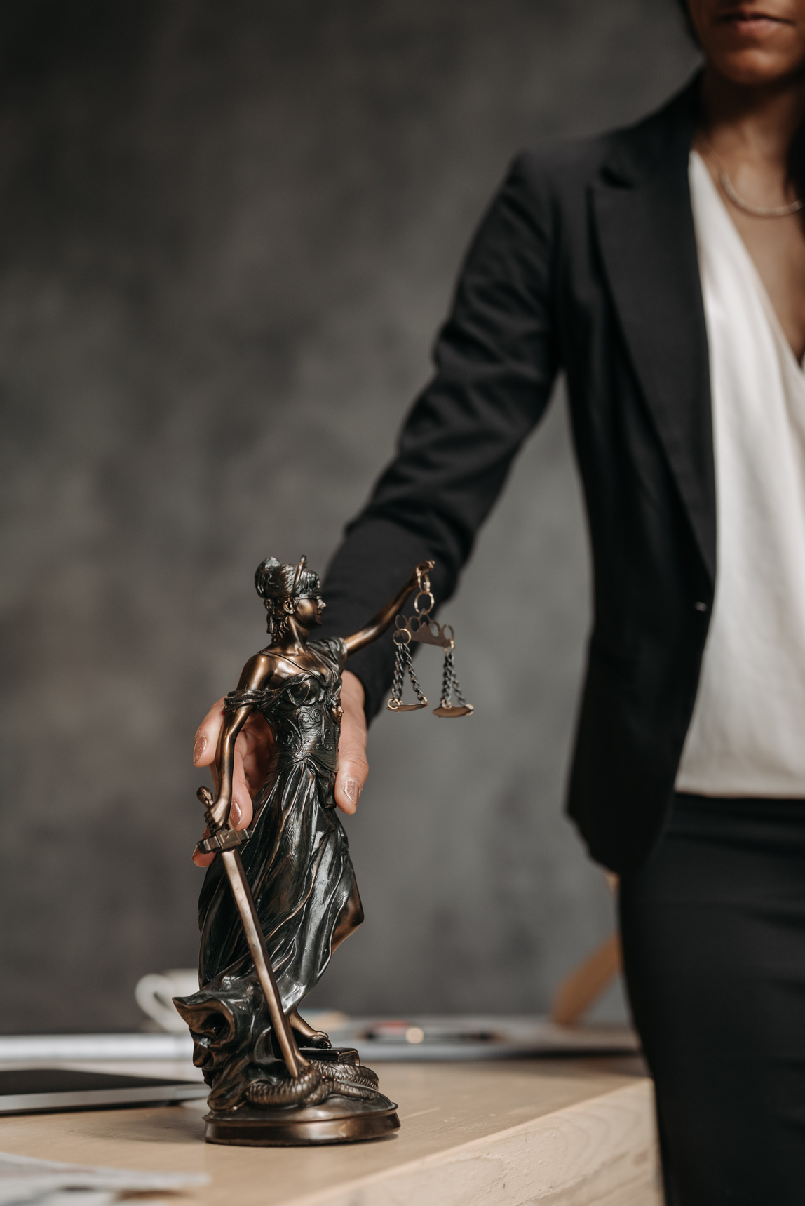

SOCIETAL
Stronger Equity
BENEFITS
Shared resource systems make sustainability more accessible, affordable, and inclusive for society.
Healthier Communities
Cleaner environments reduce risks of disease, improve quality of life, and protect urban populations.

Slide 12
EMPOWERING THE NEXT GENERATION OF SUSTAINABLE
Instilling Environmental ResponsibilityTeaching kids about sustainability helps them develop a sense of environmental management from an early age.
Preparing for Future Green Career
Equipping students with knowledge about green business prepares them for careers in emerging
eco-friendly industries.
Fostering Critical Thinking
Encourages young people to think critically about corporate responsibility and ethical practices,
shaping them into responsible future leaders.
Inspiring Innovation
Educating youngsters about green business inspires them to develop innovative solutions for
environmental challenges, fueling future advancements in sustainability.

Slide 13

THANK
YOU
Together for a Circular Future
Circular economy is our pathway to sustainability. Thank you for your attention.

