Slide 1







Discovering you talents in Green Enterpreneurship
SWOT Analysis
Presentation by
Io Chatzivaryti
Senior Expert in EU Projects
Drama Chamber
Notes:
Hello everyone! Welcome to our workshop on green entrepreneurship. Today, we'll discover how your personal talents, interests, and goals can help you create a greener, better future. We’ll use two powerful tools – SWOT analysis and a Japanese concept called Ikigai – to explore how you can turn your ideas into impact

Slide 2

Why Green Enterpreneurship
1
3
Help the Environment and the Society
Make a difference
Your unique talents and passions can make a difference!
2
Lead the way
Lead the way in solving climate and social problems
Notes:
Green entrepreneurship is all about creating businesses that solve environmental and social problems. Whether it’s reducing plastic waste, developing clean energy, or promoting eco-fashion, YOU can lead these changes. Your age doesn’t limit your impact—your ideas, energy, and creativity are what matter

Slide 3
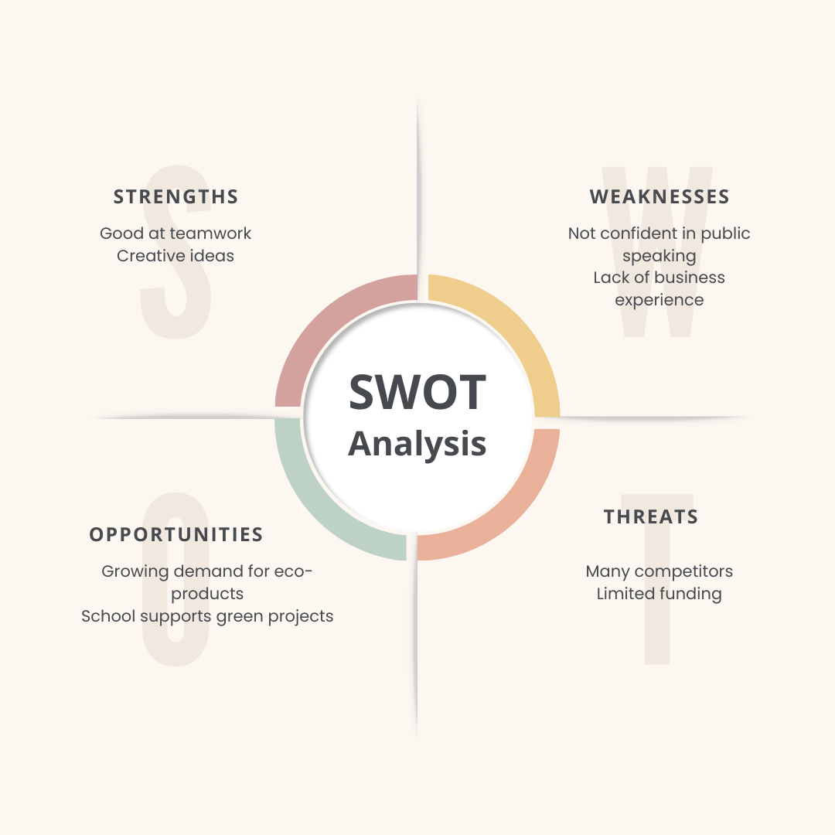
What is SWOT Analysis?
Swot stands for:
S
o
Strenghts
Opportunities
What you do well
Chances to grow
W
T
Weakenesses
Threats
Areas to improve
Challenges to watch out for
Notes:
SWOT is a simple but powerful tool. It helps you look inward and outward. What are you good at? What holds you back? What chances could help you?

Slide 4
1. Small Café
SWOT analysis examples
Strengths | Weaknesses
Unique homemade recipes | Limited seating capacity
Strong local customer base | High staff turnover
Cozy ambiance and friendly service | No online ordering or delivery system
Opportunities | Threats
Expand into catering services | Rising food costs
Launch loyalty program/mobile app | New local competitors
Collaborate with local events | Changing dietary preferences
Notes:
SWOT is a simple but powerful tool. It helps you look inward and outward. What are you good at? What holds you back? What chances could help you?

Slide 5
SWOT analysis examples
2. Tech Startup
Strengths | Weaknesses
Patent-pending innovative product | Low brand recognition
Technically skilled, motivated team | Limited marketing budget
Agile development processes | Product line not diversified
Opportunities | Threats
Rising demand for automation tools | Rapid tech evolution
Potential B2B partnerships | Well-funded competitors
Innovation grants available | Regulatory uncertainty

Slide 6

Why use the SWOT as a student?
1
Discover talents and interests
3
Make better goals
2
Set realist goals
Notes:
As students, you’re still figuring out your strengths and goals. SWOT helps you reflect and plan. When we connect this to green entrepreneurship, it becomes a tool for discovering how you can contribute to a more sustainable future

Slide 7
How to do a personal SWOT analysis
S
o
Strenghts
Opportunities
Skills, knowledge, personality traits
Programs, networks, trends
W
T
Weaknesses
Threats
Challenges, fears, skill gaps
Obstacles, competition, lack of access
Notes:
Let’s break this down:
• Strengths: Are you good at presenting? Problem-solving? Writing?
• Weaknesses: Do you struggle with time management or math?
• Opportunities: Erasmus+ projects, green competitions, school initiatives
• Threats: Lack of experience, limited access to tools or funding"

Slide 8
Example of a personal SWOT analysis
Strengths | Weaknesses
Strong communication skills | Limited analytics experience
Experience with funding tools | Public speaking anxiety
Strong clientele base | Already busy working schedule
Opportunities | Threats
Take time management courses | Competition form bigger consultancies
Built a partnership network to support my work load | Low skilled professionals
Freelance to build portfolio | Money flows that relate to EU funding

Slide 9
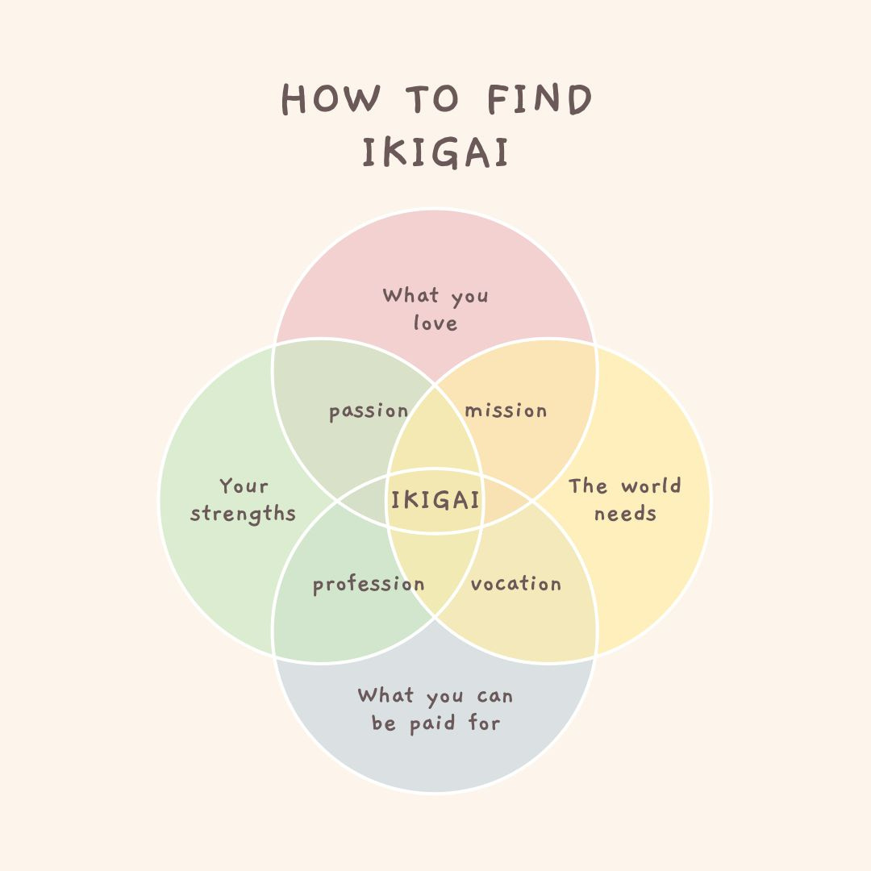
What is IKIGAI
1
What you love
2
What you are good at
3
What the world needs
4
What you can be paid for
Notes:
• Ikigai = Japanese for “reason for being”
• It combines:
o What you love
o What you’re good at
o What the world needs
o What you can be paid for
Speaker Notes: "Ikigai helps you find a meaningful life and career. When you do something you love, that you’re good at, that people need, and you can be paid for—it’s fulfilling and sustainable. That’s exactly the kind of thinking we need in green entrepreneurship."

Slide 10

IKIGAI matters to you?
1
3
Helps you find purpose
Connects talents to real-world needs
2
4
Guides your future purpose
Builds professional motivation
Notes:
Many people drift through school or careers without a clear sense of direction. Ikigai gives you focus. When your purpose is tied to something you care about—like the environment—you’re more likely to stay motivated, and your work has real impact.

Slide 11

SWOT +IKIGAI for Green Enterpreneurship
2
1
Use ikigai to find your unique green path
Use SWOT to know your self and your situation
3
Together, they help you:
  Define goals,
  find opprotunities,
  build a meaningful future.
Notes:
SWOT gives you clarity. Ikigai gives you direction. Together, they help you create your personal green entrepreneurship roadmap. Whether you want to invent, lead, support, or teach—there’s a role for you

Slide 12


Green Enterpreneurial talents
1
3
Strengths
Opportunities
Creativity, Science,teamwork
Green Clubs, eco fairs, start up competitions
2
IKIGAI
Passion for nature, skill in video editing, desire to help
Notes:
Let’s say someone loves photography, is good at social media, and wants to protect nature. Their Ikigai might be eco-storytelling—raising awareness through content. Green entrepreneurship can look like a tech app, a sustainable product, or even an educational platform

Slide 13
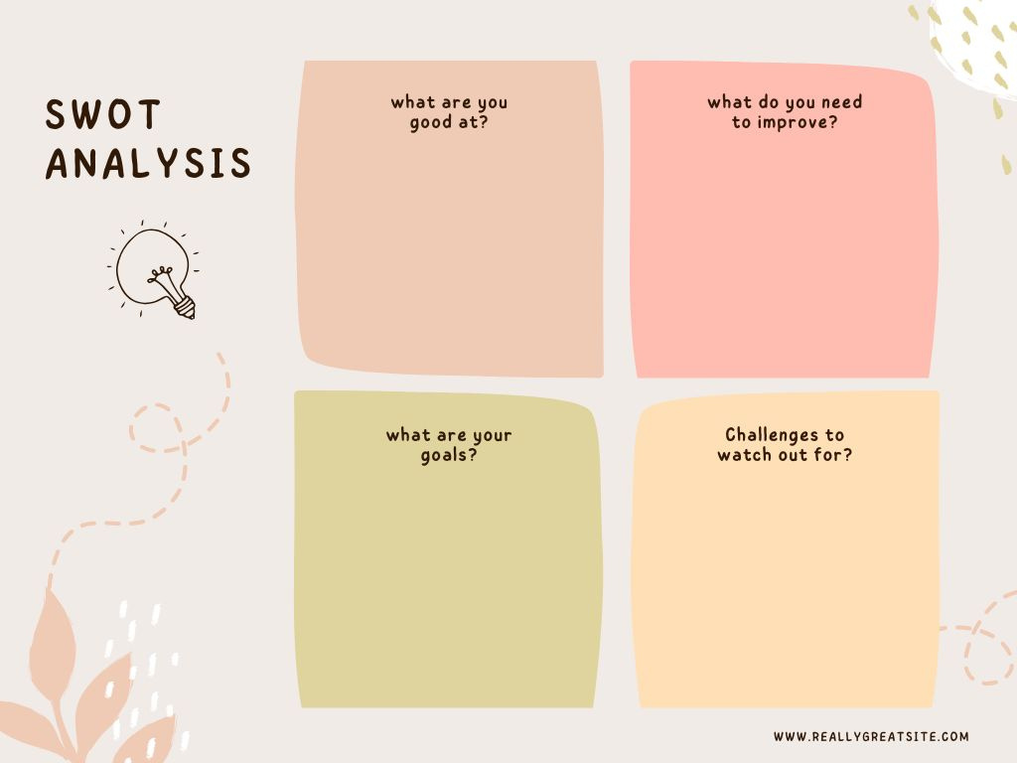
Workshop
1
Create your personal SWOT
2
Use IKIGAI to inspire your answers
3
Work in pairs
4
Share your findings
Notes:
• In groups, you’ll create your own SWOT analysis.
• Think about:
o Your strengths and weaknesses (skills, knowledge, attitudes)
o Opportunities and threats in green entrepreneurship (trends, challenges)
• Use the worksheet provided.
Sample presentation

Slide 14


for your SWOT IKIGAI
Be honest and specific
Think about hobbies, classes, and the causes you care about
Ask your friends/teachers for their input
Link your talents to environmental change
Notes:
Need help? Think about your proudest moments. What do people ask you for help with? What excites you? These clues help build your SWOT and Ikigai

Slide 15

Resources of Inspiration
Erasmus+ Green Projects
Youth climate networks
Eco-entrepreneur videos (YouTube, TEDx)
https://youtu.be/jyYjI7zQlaA?si=K6FPm2-xAyE1NgVx
Teachers, mentors
Notes:
You’re not alone! There are Erasmus+ programs, global youth networks, and inspiring stories of young people just like you making change. Look around and find your tribe
https://www.greenerasmus.org/
1. UNESCO Youth Climate Action Network (YoU-CAN)
YoU-CAN is a UNESCO flagship platform that connects youth climate networks worldwide to enhance cooperation and upscale youth-led climate action and research. It focuses on four thematic areas: Education, Sciences, Culture, and Communication for Climate Action. The network was launched in 2019 during COP25 in Madrid to bring together active and passionate young climate leaders and support them in building a sustainable future. ​
climatecardinals.org+6smartagri.org+6Log in or sign up to view+6
UNESCO
2. Global Youth Climate Network (GYCN)
GYCN is an initiative under the World Bank Group’s Youth-to-Youth Community. It aims to engage the youth community both within and outside the World Bank Group to participate in climate initiatives that raise awareness on climate issues and mitigate the impacts of climate change. ​
LinkedIn+2sdghelpdesk.unescap.org+2Log in or sign up to view+2
3. Youth4Climate (Y4C)
Youth4Climate is a global initiative co-led by Italy and the United Nations Development Programme (UNDP). It supports the implementation of youth-led and youth-inclusive solutions to environmental and climate challenges, both financially and through capacity development, for a more innovative and inclusive impact on the ground. ​
connect4climate.org+4community.youth4climate.info+4UNDP+4
UNDP+1UNDP Climate Promise+1
4. Climate Cardinals
Climate Cardinals is a youth-led organization focused on making climate action accessible to non-English speakers through translation and education. Since its founding in 2020, it has mobilized over 16,000 volunteers across 134 countries, translating millions of words of climate-related content into more than 105 languages. The organization has reached approximately 11 million people worldwide.

Slide 16


Discussion
Where do your answers overlap?
How your talents can help develop a green future?
Brain storm on green start-ups
Notes:
Need help? Think about your proudest moments. What do people ask you for help with? What excites you? These clues help build your SWOT and Ikigai

Slide 17

Thank you and next steps
Thank you for joining!
Grab your phones
Let’s begin your SWOT & Ikigai activity
Your green journey starts now! https://docs.google.com/forms/d/e/1FAIpQLSfr9Ti1sDj7tasO2jDK2jswMirpPzEyHcCtrtH4rdrElHzY5g/viewform?pli=1
Notes:
You’re not alone! There are Erasmus+ programs, global youth networks, and inspiring stories of young people just like you making change. Look around and find your tribe
https://www.greenerasmus.org/
1. UNESCO Youth Climate Action Network (YoU-CAN)
YoU-CAN is a UNESCO flagship platform that connects youth climate networks worldwide to enhance cooperation and upscale youth-led climate action and research. It focuses on four thematic areas: Education, Sciences, Culture, and Communication for Climate Action. The network was launched in 2019 during COP25 in Madrid to bring together active and passionate young climate leaders and support them in building a sustainable future. ​
climatecardinals.org+6smartagri.org+6Log in or sign up to view+6
UNESCO
2. Global Youth Climate Network (GYCN)
GYCN is an initiative under the World Bank Group’s Youth-to-Youth Community. It aims to engage the youth community both within and outside the World Bank Group to participate in climate initiatives that raise awareness on climate issues and mitigate the impacts of climate change. ​
LinkedIn+2sdghelpdesk.unescap.org+2Log in or sign up to view+2
3. Youth4Climate (Y4C)
Youth4Climate is a global initiative co-led by Italy and the United Nations Development Programme (UNDP). It supports the implementation of youth-led and youth-inclusive solutions to environmental and climate challenges, both financially and through capacity development, for a more innovative and inclusive impact on the ground. ​
connect4climate.org+4community.youth4climate.info+4UNDP+4
UNDP+1UNDP Climate Promise+1
4. Climate Cardinals
Climate Cardinals is a youth-led organization focused on making climate action accessible to non-English speakers through translation and education. Since its founding in 2020, it has mobilized over 16,000 volunteers across 134 countries, translating millions of words of climate-related content into more than 105 languages. The organization has reached approximately 11 million people worldwide.

Slide 18



Do not edit
How to change the design
What's one strength you’re proud of that helps you thrive in your current life?
The Slido app must be installed on every computer you’re presenting from

Slide 19

Do not edit
How to change the design
How confident are you in identifying your personal strengths and opportunities?
The Slido app must be installed on every computer you’re presenting from

